Slide 1
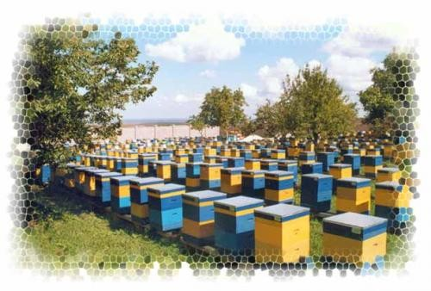
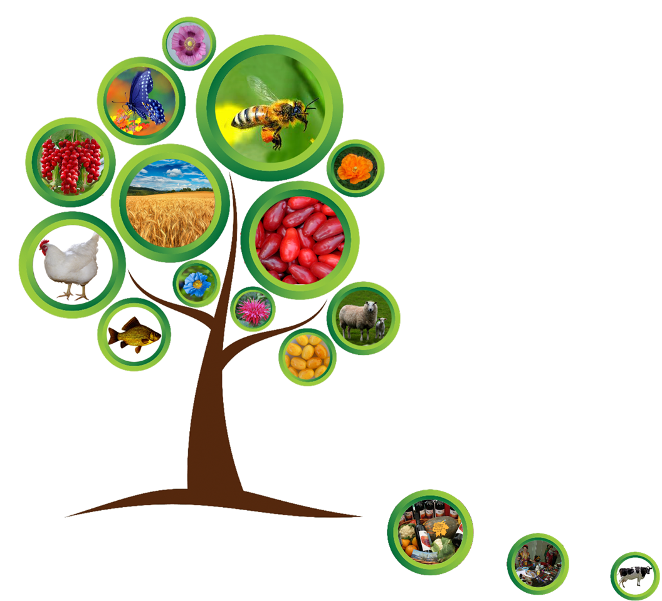




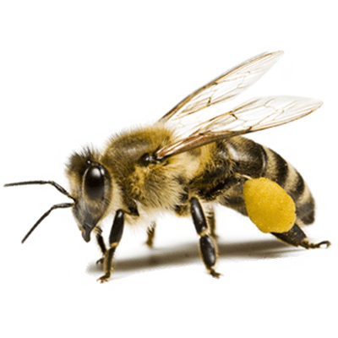

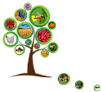
Slovak University of Agriculture in Nitra
Faculty of Agrobiology and Food Resources
Institute of Biodiversity Conservation and Biosafety
in cooperation with
Armenian National Association of Beekeepers, Armenia
Yerevan State University, Armenia
International On line Conference
„ BEE PRODUCTS IN FOOD“
October 30-31th, 2020, Yerevan, Armenia with opening at 9:30 am (AMT)
Yerevan Expo Center
The conference program is available at http://bee-educa.uniag.sk
President of Conference Mrs Roza Levonovna Tsarukyan – Research and Production Center "Multi Agro"
The international conference was prepared by a collective of the Institute of Biodiversity Conservation and Biosafety at the Faculty of Agrobiology and Food Resources within the international AgroBioNet network with the active cooperation of 12 research and educational institutions from Poland, Hungary, Ukraine, Armenia, Moldova and Republic of Serbia as partners and guarantors of the international project
„Save endangered bees to improve nutrition, health and life quality of human“
Project supported by Grant from International Visegrad Fund V4 countries
of European Union under number 21910411

